Slide 1

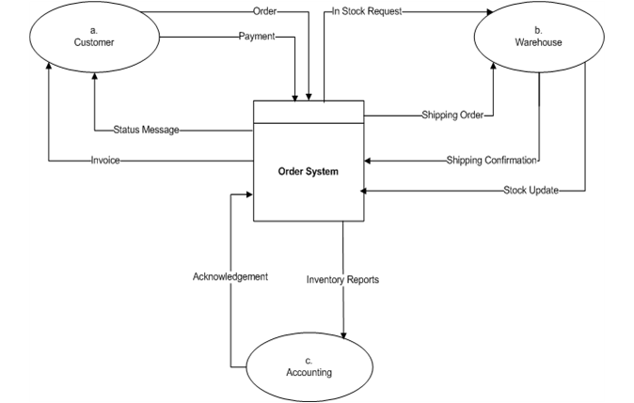
HI5030 Business Systems Analysis and Design
Tutorial Week 05 – Tutor Dr. Farshid Keivanian
We are using draw.io to create requirement models. This semester we are using free online UML tool called “draw.io” to create requirements models. You can access this fantastic free online tool by clicking the following link: www.draw.io
Draw.io is built around Google Drive, so team members can easily work on their models remotely via any computer, share and save any diagram into a common Google Drive folder. You need to authorize draw.io to use your Google Drive account. An 8-minute tutorial for using draw.io: https://www.youtube.com/watch?v=yNC aYi2Hk
08
Case Study 1 – Order System

Slide 2
HI5030 Business Systems Analysis and Design
Tutorial Week 05 – Tutor Dr. Farshid Keivanian
1. Decompose the above system into processes and develop level 0 DFD diagram.
2. Write data directories for the following:
Order data flow
Payment data flow
Any selected data store from your level 0 DFD
08

Slide 3
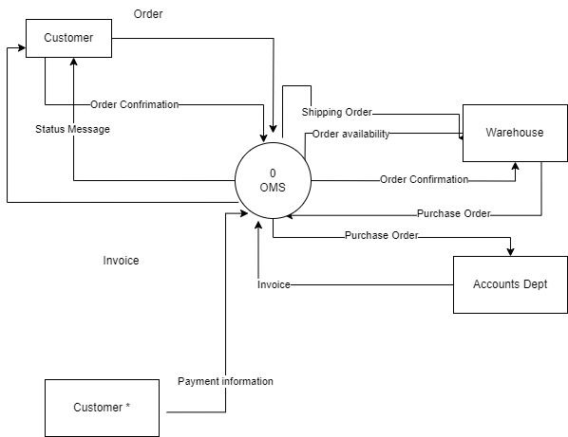
Step 1: Decompose the Case Study Order System into Processes
The case study order system provided in the first question shows a high-level interaction between the "Order System" and the external entities: "Customer," "Warehouse," and "Accounting."

Slide 4
Decomposition into Processes
Here’s how the system can be decomposed into processes for a Level 0 Data Flow Diagram (DFD):
Process 1: Place Order
Input: Order (from Customer)
Output: New Order Record (to Order Data Store), Order Confirmation (to Customer), Status Message (to Customer), Shipping Order (to Warehouse)

Slide 5
2. Process 2: Verify Order
Input: Order Details (from Order Data Store), Purchase Order (from Accounting Department), Shipping Order (from Warehouse)
Output: Order Confirmation (to Customer), Purchase Order (to Warehouse)
3. Process 3: Process Payment
Input: Payment (from Customer), Purchase Order (from Verify Order)
Output: Payment Information (to Accounting Department), Invoice (to Customer)

Slide 6
4. Process 4: Update Stock and Inventory
Input: Shipping Confirmation (from Warehouse), Stock Update (from Warehouse)
Output: Inventory Reports (to Accounting), Acknowledgment (to Order System)

Slide 7
Step 2: Develop a Level 0 Data Flow Diagram (DFD)
A Level 0 DFD would include these processes interacting with data stores and external entities (Customer, Warehouse, and Accounting).
Step 3: Write Data Directories
Order Data Flow
Source: Customer
Destination: Place Order Process
Description: Contains order details including customer information, items ordered, and quantity.

Slide 8
2. Payment Data Flow
Source: Customer
Destination: Process Payment Process
Description: Contains payment details such as payment method, amount, and customer information.
3. Selected Data Store: Order Data Store
Description: Stores all the order details after the order is placed. It includes information on order status, items ordered, customer details, and order history.

Slide 9
This is a Level 0 DFD, which matches the requirement. It corresponds to the Level 0 DFD as it shows a high-level view of the system. It shows the major processes without diving into detailed subprocesses.

Slide 10
HI5030 Business Systems Analysis and Design
Tutorial Week 05 – Tutor Dr. Farshid Keivanian
Question) Clarify on question c
2. Write data directories for the following:
c) Any selected data store from your level 0 DFD
The instruction "Any selected data store from your level 0 DFD" asks you to choose one data store from the Level 0 Data Flow Diagram (DFD) and then describe it in a data dictionary format.
Here’s how we can proceed:
Step 1: Identify the Data Stores in Your Level 0 DFD
From your Level 0 DFD, you have the following data stores:
Order Data Store: Stores all the orders placed by customers.
Payment Data Store: Stores payment information received from customers.
Warehouse Data Store: Stores information about available stock and inventory.
08

Slide 11
HI5030 Business Systems Analysis and Design
Tutorial Week 05 – Tutor Dr. Farshid Keivanian
Question) Clarify on question c
2. Write data directories for the following:
c) Any selected data store from your level 0 DFD
Step 2: Select a Data Store
Select one of the above data stores. For this example, let’s assume you choose the Order Data Store.
Step 3: Write the Data Dictionary for the Selected Data Store
The data dictionary entry for the selected data store should include the following:
Name: The name of the data store.
Description: What kind of data it stores.
Type: The type of data structure (e.g., file, table).
Format: The format of the data.
Usage: How the data is used in the system.
Access: Who can access it and how it’s accessed.
08

Slide 12
HI5030 Business Systems Analysis and Design
Tutorial Week 05 – Tutor Dr. Farshid Keivanian
Question) Clarify on question c
2. Write data directories for the following:
c) Any selected data store from your level 0 DFD
Example Data Dictionary Entry for "Order Data Store":
Name: Order Data Store
Description: This data store holds all the order details that customers place through the Order Management System. It includes customer information, items ordered, quantities, prices, and order status.
Type: Database Table
Format: Each order is recorded as a row in the table with columns for Order ID, Customer ID, Item ID, Quantity, Price, Order Date, and Status.
Usage: Used to retrieve and update order information during order processing, verification, and payment processes. Also used to generate reports for inventory management and sales analysis.
Access: Accessed by the Order Management System processes such as 'Place Order,' 'Verify Order,' and 'Process Payment.' Only authorized personnel and system processes can modify this data.
You would write a similar entry for whichever data store you select from your DFD. This description gives a clear understanding of the role and structure of the data within the system.
08

Slide 13
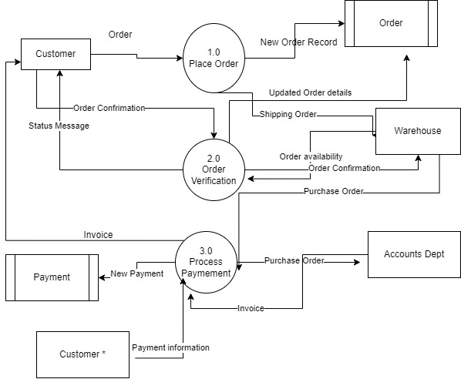
The diagram represents a more detailed Data Flow Diagram (DFD) that breaks down the processes involved in an order processing system. It is a Level 1 DFD, which decomposes the main process of an order system into subprocesses like "Place Order," "Order Verification," and "Process Payment."

Slide 14
Breakdown:
Process 1.0: Place Order
This subprocess handles receiving the order from the customer, creating a new order record, and sending order confirmation back to the customer.
Process 2.0: Order Verification
This subprocess verifies the order details, interacts with the warehouse to check order availability, and confirms the order.
Process 3.0: Process Payment
This subprocess handles the payment processing, interacts with the accounting department, and sends the payment information and invoice to the customer.

Slide 15
Determining the Level:
Level 1 DFD: This diagram is a more detailed breakdown of a system, which is consistent with what you would expect in a Level 1 DFD. It decomposes the higher-level processes into more detailed steps.

Slide 16
Level 0 DFD:
The Level 0 DFD would consist of a single process (e.g., "Order System") interacting with the external entities (Customer, Warehouse, and Accounting Department) and would not be broken down into these specific subprocesses.
Data Directories:
The data directories for "Order data flow," "Payment data flow," and a selected data store would be written based on the context provided in the Level 0 DFD, detailing the contents and attributes of each data flow and data store.
Conclusion:
The diagram is a Level 1 DFD. For a Level 0 DFD, we should simplify this diagram by showing the entire order process as a single entity interacting with external entities without breaking it down into subprocesses.

Slide 17
Case Study 2 - Estate Agency
Clients wishing to put their property on the market visit the estate agent, who will take details of their house, flat or bungalow and enter them on a card which is filed according to the area, price range and type of property. Potential buyers complete a similar type of card which is filed by buyer name in an A4 binder. Weekly, the estate agent matches the potential buyer's requirements with the available properties and sends them the details of selected properties.
Draw a context diagram
Draw a level 0 DFD
Draw a level 1 DFD for any selected from the level 0 DFD
Write a data dictionary for any selected DFD element from above diagram

Slide 18
1. Draw a Context Diagram
A context diagram provides an overview of the system by showing it as a single process and all external entities interacting with it.
Entities:
Clients (Sellers): Provide property details.
Potential Buyers: Provide their requirements for properties.
Estate Agency System: Matches potential buyers with available properties and sends property details to the buyers.
Data Flows:
Property Details: From Clients to Estate Agency.
Buyer Requirements: From Potential Buyers to Estate Agency.
Property Matches: From Estate Agency to Potential Buyers.
Please complete this DFD and send it to Fkeivanian@my.holmes.edu.au
Clients
Potential Buyers
Estate Agency System

Slide 19
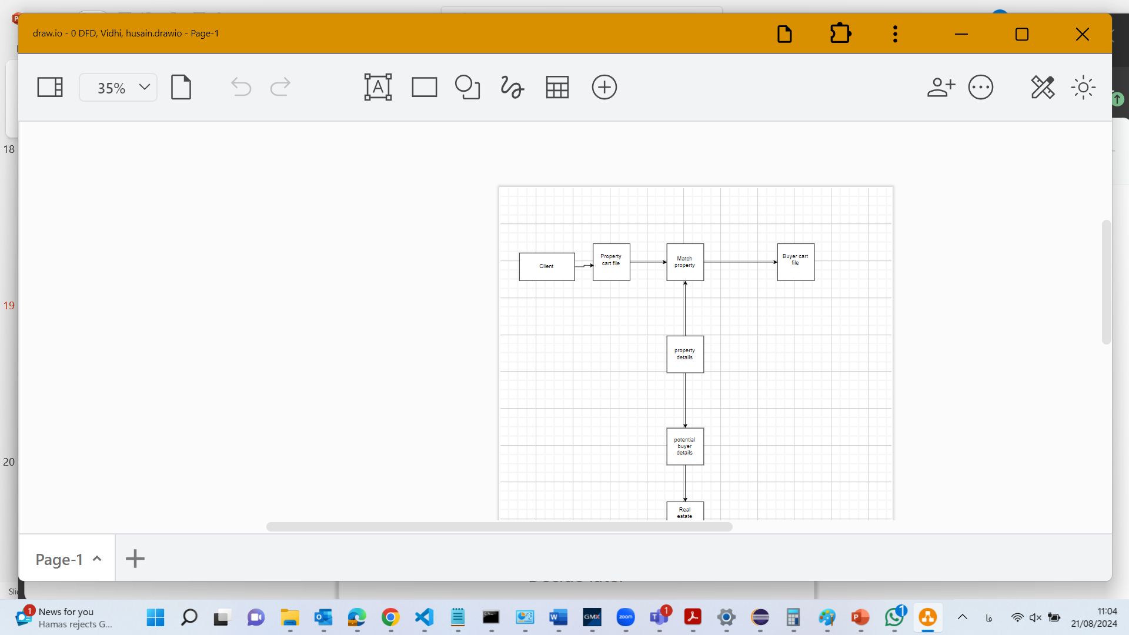

Slide 20
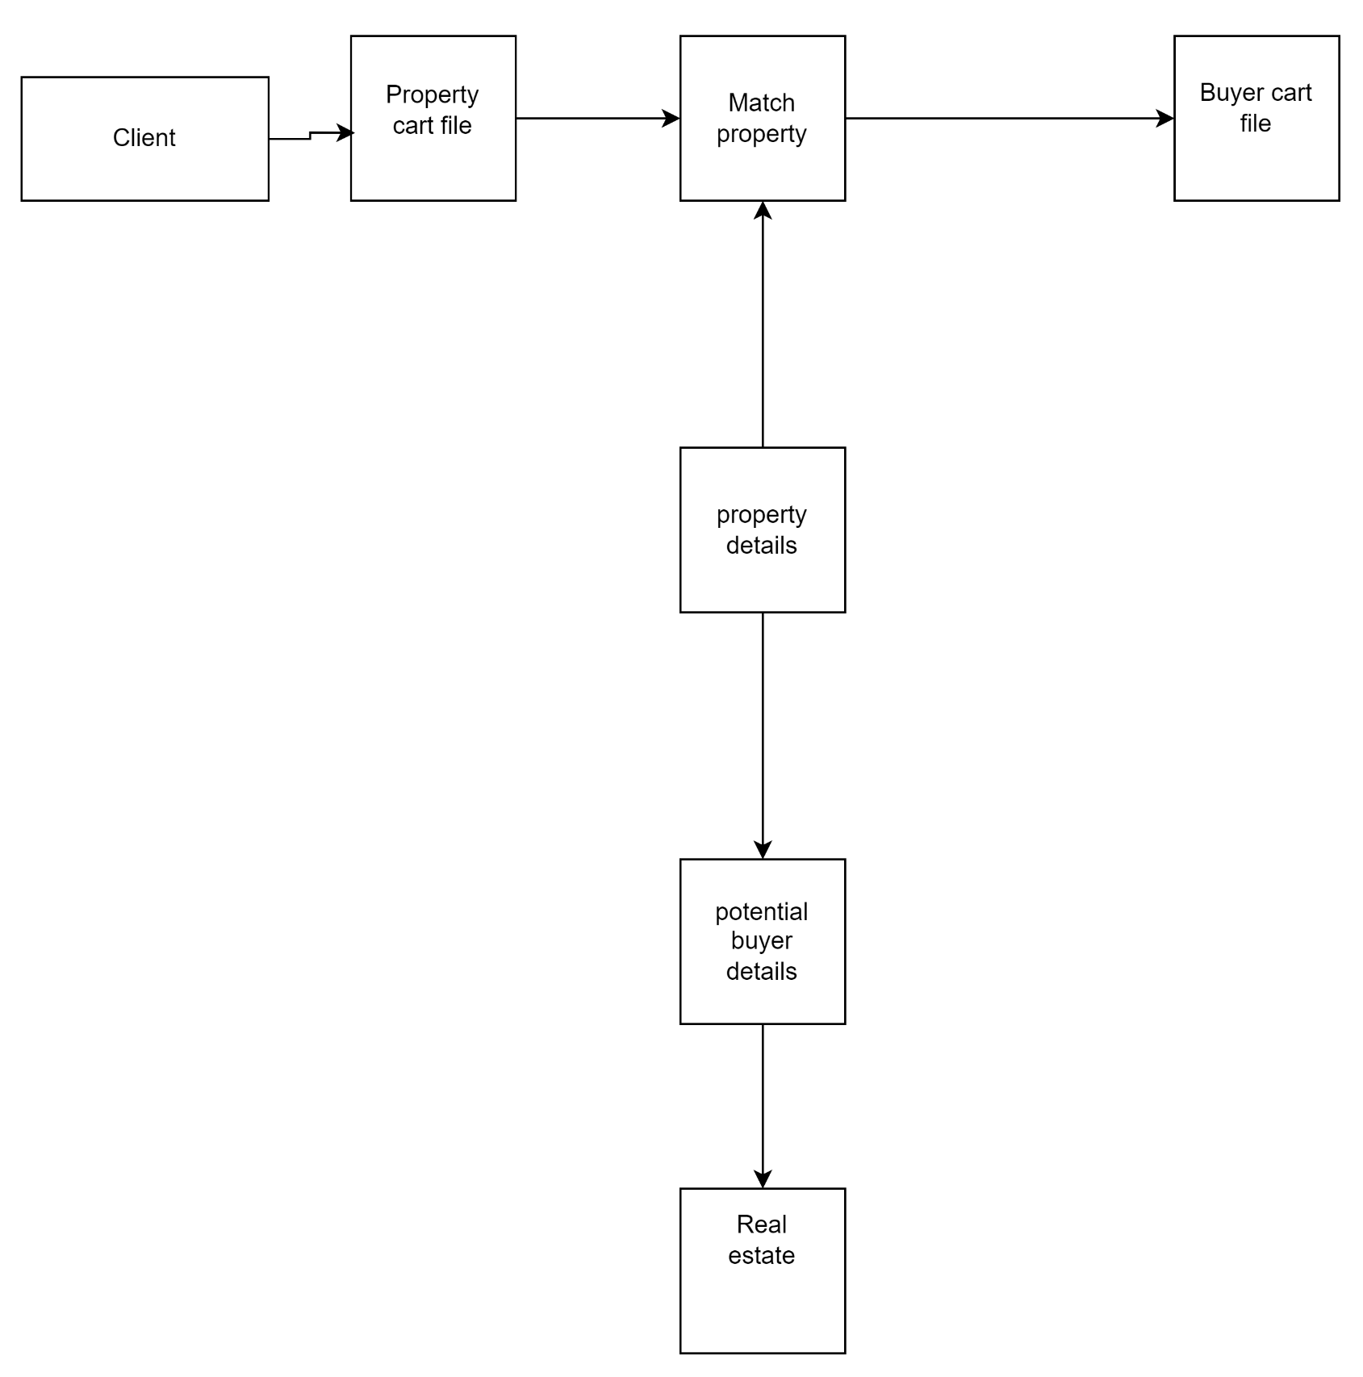

Slide 21
Context Diagram
Here is the context diagram for the Estate Agency case study based on the context and level 0 data flow diagrams (DFDs). This visual representation shows the step-by-step process:
Receive Property Details: The system receives property details from clients.
Receive Buyer Requirements: The system receives buyer requirements from potential buyers.
Match Properties: The system matches the properties with the buyer requirements.
Send Property Details: The system sends the matched property details to the potential buyers.
The flowchart also includes the data stores for property and buyer details, illustrating the interaction between these elements within the system.

Slide 22
2. Draw a Level 0 DFD
A Level 0 DFD shows the main processes within the system.
Processes:
Receive Property Details: Takes property information from clients.
Receive Buyer Requirements: Takes requirements from potential buyers.
Match Properties: Matches properties with buyer requirements.
Send Property Details: Sends matched property details to potential buyers.
Data Stores:
Property Card File: Stores property details.
Buyer Card File: Stores buyer requirements.

Slide 23
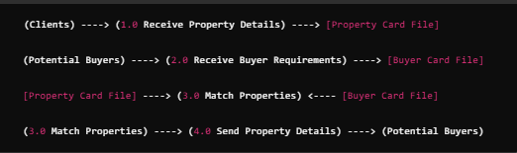
Level 0 DFD
Receive Property Details: The system receives property details from clients.
Receive Buyer Requirements: The system receives buyer requirements from potential buyers.
Match Properties: The system matches the properties with the buyer requirements.
Send Property Details: The system sends the matched property details to the potential buyers.
The flowchart also includes the data stores for property and buyer details, illustrating the interaction between these elements within the system.

Slide 24
3. Draw a Level 1 DFD for a Selected Process
Let’s select "3.0 Match Properties" for a Level 1 DFD.
Processes:
Retrieve Property Data: Fetches property data from the Property Card File.
Retrieve Buyer Data: Fetches buyer data from the Buyer Card File.
Compare Requirements: Matches buyer requirements with property details.
Generate Match List: Creates a list of matched properties.
Data Stores:
Property Data
Buyer Data

Slide 25
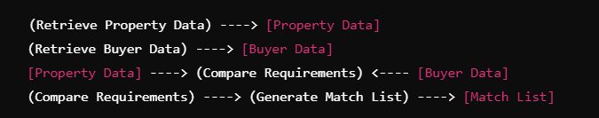
Level 1 DFD for "Match Properties"
4. Write a Data Dictionary for a Selected DFD Element
Let’s choose the "Property Card File" data store for the data dictionary.
Property Card File Data Store:
Data Store Name: Property Card File
Description: A collection of all property details provided by clients. The data store contains property type, location, price range, and unique identifiers.
Attributes:
Property ID: Unique identifier for each property.
Property Type: The type of property (house, flat, bungalow).
Location: The area or location of the property.
Price Range: The price range of the property.
Status: Availability status of the property (available, sold, etc.).

Slide 26
Case Study 3 - Estate Agency (part 2)
When a sale is completed, the buyer confirms that the contracts have been exchanged, client details are removed from the property file, and an invoice is sent to the client. The client receives the top copy of a three part set, with the other two copies being filed. On receipt of the payment the invoice copies are stamped and archived. Invoices are checked on a monthly basis and for those accounts not settled within two months a reminder (the third copy of the invoice) is sent to the client.
Draw a context diagram
Draw a level 0 DFD
Draw a level 1 DFD for any selected from the level 0 DFD
Write a data dictionary for any selected DFD element from the above diagram
Please complete this DFD and send it to Fkeivanian@my.holmes.edu.au

Slide 27
Case Study 3 - Estate Agency (Part 2)
When a sale is completed, the buyer confirms that the contracts have been exchanged, client details are removed from the property file, and an invoice is sent to the client. The client receives the top copy of a three-part set, with the other two copies being filed. On receipt of the payment, the invoice copies are stamped and archived. Invoices are checked on a monthly basis, and for those accounts not settled within two months, a reminder (the third copy of the invoice) is sent to the client.

Slide 28
Step 1: Draw a Context Diagram
A context diagram provides a high-level view of the system as a single process and shows the external entities that interact with it.
Entities:
Buyer: Confirms contract exchange.
Client: Receives invoice and sends payment.
Invoice System: Manages invoicing, payments, and reminders.
Data Flows:
Contract Confirmation: From Buyer to Invoice System.
Invoice: From Invoice System to Client.
Payment: From Client to Invoice System.
Reminder: From Invoice System to Client.

Slide 29
The context diagram will have a central process "Invoice System" with arrows indicating the flow of information between the system and the external entities (Buyer and Client).
Step 2: Draw a Level 0 DFD
A Level 0 Data Flow Diagram (DFD) breaks down the main processes within the system.
Processes:
Receive Contract Confirmation: Receives confirmation that the contract has been exchanged.
Generate Invoice: Creates and sends an invoice to the client.
Receive Payment: Receives payment from the client.
Archive Invoice: Archives stamped invoice copies.
Check Payments: Monthly check of invoices to see if payment has been received.
Send Reminder: Sends a reminder to clients who haven't paid within two months.

Slide 30
Data Stores:
Property File: Stores client and property details.
Invoice File: Stores invoices and their statuses (issued, paid, archived).
Reminder File: Stores reminders for unpaid invoices.
In the Level 0 DFD, these processes will be connected with data stores and external entities through data flows.
Step 3: Draw a Level 1 DFD for Any Selected Process from Level 0
Select a process from the Level 0 DFD for further decomposition. Let's choose "3. Receive Payment."

Slide 31
Level 1 DFD for "Receive Payment":
Processes:
Match Payment with Invoice: Checks if the received payment corresponds to an issued invoice.
Stamp Invoice: Stamps the invoice as paid.
Update Invoice Status: Updates the status of the invoice to "Paid."
Archive Invoice: Archives the stamped invoice.
Data Stores:
Invoice File: Stores the details of all issued invoices.
Payment File: Stores the details of all received payments.
The Level 1 DFD will show these detailed processes with connections to the relevant data stores and external entities.

Slide 32
Step 4: Write a Data Dictionary for Any Selected DFD Element
Choose one DFD element from the diagrams above. Let's choose the Invoice File for this example.
Data Dictionary Entry for "Invoice File":
Name: Invoice File
Description: This file stores all invoices generated by the system. It includes the invoice number, client details, property details, amount due, date of issue, payment status, and any reminders sent.
Type: Database Table
Format: Each invoice is recorded as a row in the table with columns for Invoice ID, Client ID, Property ID, Amount, Issue Date, Due Date, Payment Status, and Reminder Sent.
Usage: Used to track the status of all invoices. Accessed by processes such as "Generate Invoice," "Receive Payment," "Archive Invoice," and "Send Reminder."
Access: Accessed by the Invoice System processes. Only authorized personnel can modify this data.

Slide 33
Summary:
Context Diagram shows the overall interaction between the Invoice System and external entities.
Level 0 DFD breaks down the main processes involved in invoicing, payment receipt, and reminders.
Level 1 DFD for "Receive Payment" further decomposes this process into more detailed steps.
Data Dictionary entry for "Invoice File" provides detailed information on how this data store is structured and used.
This approach provides a complete and clear understanding of the Estate Agency's invoicing process, from contract confirmation to payment and reminders.

Slide 34
Creating Data Flow Diagrams
Lemonade Stand Example

Slide 35
Creating Data Flow Diagrams
Example
Steps:
The operations of a simple lemonade stand will be used to demonstrate the creation of dataflow diagrams.
Create a list of activities
Old way: no Use-Case Diagram
New way: use Use-Case Diagram
Construct Context Level DFD (identifies sources and sink)
Construct Level 0 DFD (identifies manageable sub processes )
Construct Level 1- n DFD (identifies actual data flows and data stores )

Slide 36
Creating Data Flow Diagrams
Example
Create a list of activities
Think through the activities that take place at a lemonade stand.
Customer Order
Serve Product
Collect Payment
Produce Product
Store Product

Slide 37
Creating Data Flow Diagrams
Example
Create a list of activities
Also think of the additional activities needed to support the basic activities.
Customer Order
Serve Product
Collect Payment
Produce Product
Store Product
Order Raw Materials
Pay for Raw Materials
Pay for Labor

Slide 38
Creating Data Flow Diagrams
Example
Create a list of activities
Group these activities in some logical fashion, possibly functional areas.
Customer Order
Serve Product
Collect Payment
Produce Product
Store Product
Order Raw Materials
Pay for Raw Materials
Pay for Labor

Slide 39
Creating Data Flow Diagrams
Example
Construct Context Level DFD (identifies sources and sink)
Create a context level diagram identifying the sources and sinks (users).
Context Level DFD
CUSTOMER
Order
0.0
Lemonade System
Sales Forecast
EMPLOYEE
Customer Order
Serve Product
Collect Payment
Produce Product
Store Product
Order Raw Materials
Pay for Raw Materials
Pay for Labor
Product Served
Production Schedule
Payment
Pay
Received Goods
Time Worked
Payment
Purchase Order
VENDOR

Slide 40
Creating Data Flow Diagrams
Example
Construct Level 0 DFD (identifies manageable sub processes )
Create a level 0 diagram identifying the logical subsystems that may exist.
Level 0 DFD
1.0
Sale
Customer Order
Serve Product
Collect Payment
Produce Product
Store Product
Order Raw Materials
Pay for Raw Materials
Pay for Labor
Customer Order
Sales Forecast
Product Ordered
CUSTOMER
Payment
2.0
Production
EMPLOYEE
Product Served
Production Schedule
VENDOR
Received Goods
3.0
Procure-ment
Inventory
Purchase Order
Order Decisions
Payment
Pay
Time Worked
4.0
Payroll

Slide 41

Creating Data Flow Diagrams
Example
Construct Level 1- n DFD (identifies actual data flows and data stores )
Create a level 1 decomposing the processes in level 0 and identifying data stores.
Level 1 DFD
CUSTOMER
Customer Order
Request for Forecast
Customer Order
Serve Product
Collect Payment
Produce Product
Store Product
Order Raw Materials
Pay for Raw Materials
Pay for Labor
1.1
Record Order
ORDER
1.3
Produce Sales Forecast
Severed Order
Payment
Sales Forecast
1.2
Receive Payment
PAYMENT

Slide 42
Creating Data Flow Diagrams
Example
Construct Level 1 (continued)
Create a level 1 decomposing the processes in level 0 and identifying data stores.
Level 1 DFD
Product Order
Customer Order
Serve Product
Collect Payment
Produce Product
Store Product
Order Raw Materials
Pay for Raw Materials
Pay for Labor
2.1
Serve Product
ORDER
Quantity Severed
Production Schedule
RAW MATERIALS
2.2
Produce Product
Quantity Used
Production Data
INVENTORTY
2.3
Store
Product
Quantity Produced & Location Stored

Slide 43
Creating Data Flow Diagrams
Example
Construct Level 1 (continued)
Create a level 1 decomposing the processes in level 0 and identifying data stores.
Level 1 DFD
Order Decision
3.1
Produce Purchase Order
PURCHASE ORDER
Customer Order
Serve Product
Collect Payment
Produce Product
Store Product
Order Raw Materials
Pay for Raw Materials
Pay for Labor
Quantity On-Hand
Quantity Received
RAW MATERIALS
Received Goods
3.2
Receive Items
RECEIVED ITEMS
Payment Approval
3.3
Pay Vendor
VENDOR
Payment

Slide 44
Creating Data Flow Diagrams
Example
Construct Level 1 (continued)
Create a level 1 decomposing the processes in level 0 and identifying data stores.
Level 1 DFD
Time Worked
4.1
Record Time Worked
TIME CARDS
Customer Order
Serve Product
Collect Payment
Produce Product
Store Product
Order Raw Materials
Pay for Raw Materials
Pay for Labor
Employee ID
EMPLOYEE
Payroll Request
4.2
Calculate Payroll
Unpaid time cards
PAYROLL
Payment Approval
4.3
Pay Employee
PAYMENTS
Payment

Slide 45
Process Decomposition
1.0
Sale
1.1
Record Order
1.2
Receive Payment
2.0
Production
2.1
Serve Product
2.2
Produce Product
2.3
Store
Product
0.0
Lemonade System
3.0
Procure-ment
3.1
Produce Purchase Order
3.2
Receive Items
3.3
Pay Vendor
4.0
Payroll
4.1
Record Time Worked
4.2
Calculate Payroll
4.3
Pay Employee
Context Level
Level 0
Level 1

Slide 46
DFD Example: Bus Garage Repairs
Buses come to a garage for repairs.
A mechanic and helper perform the repair, record the reason for the repair and record the total cost of all parts used on a Shop Repair Order.
Information on labor, parts and repair outcome is used for billing by the Accounting Department, parts monitoring by the inventory management computer system and a performance review by the supervisor.

Slide 47
DFD Example: Bus Garage Repairs (cont’d)
External Entities: Bus, Mechanic, Helper, Supervisor, Inventory Management System, Accounting Department, etc.
Key process (“the system”): performing repairs and storing information related to repairs
Processes:
Record Bus ID and reason for repair
Determine parts needed
Perform repair
Calculate parts extended and total cost
Record labor hours, cost

Slide 48
DFD Example: Bus Garage Repairs (cont’d)
Data stores:
Personnel file
Repairs file
Bus master list
Parts list
Data flows:
Repair order
Bus record
Parts record
Employee timecard
Invoices

Slide 49
Bus Garage Context Diagram
Bus
Mechanical problem
to be repaired
Fixed mechanical
problems
Helper
Bus Repair Process
System
Repair summary
Supervisor
Labor
List of parts used
Inventory Management System
Labor
Labor, parts cost details
Mechanic
Accounting

Slide 50
CSUB Burger’s Order Processing System
Draw the CSUB Burger’s context diagram
System
Order processing system
External entities
Kitchen
Restaurant
Customer
Processes
Customer order
Receipt
Food order
Management report

